Slide 1
R’s
Pizza bot

Slide 2
APi’s used
Restaurant details api from Zomato for location https://app.swaggerhub.com/apis-docs/Vivek-Raj/zomato-api/1.0.0
Weather api from open weather https://openweathermap.org/api

Slide 3
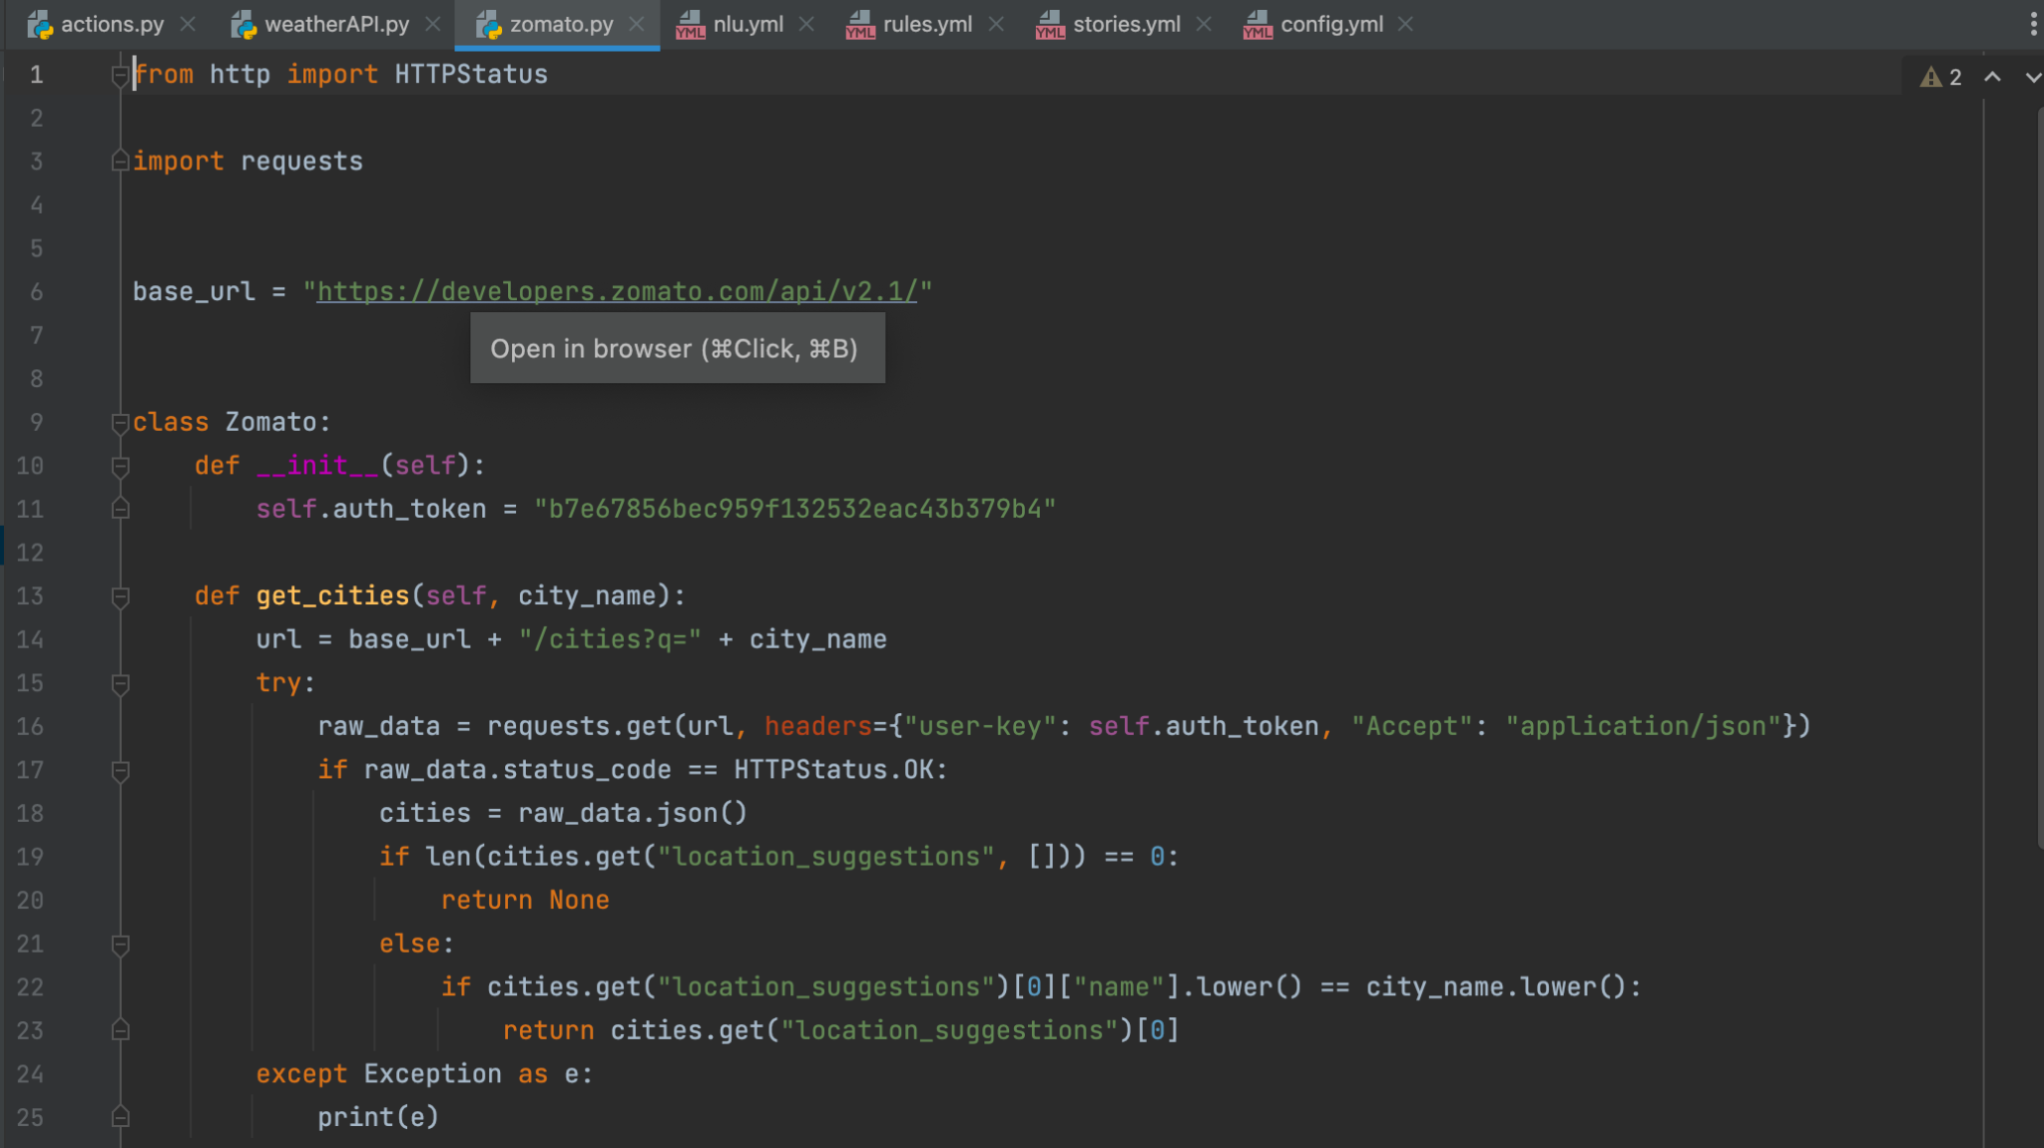
Zomato Api

Slide 4
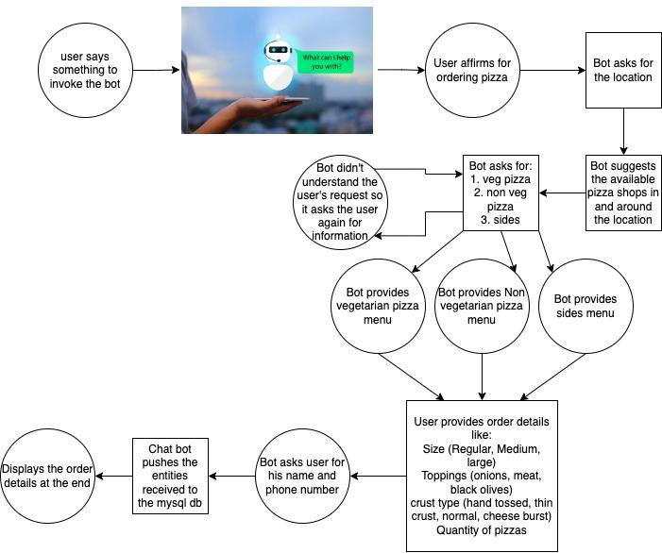
Work-flow

Slide 5
Challenges faced
Handling all kinds of user intents
Rasa version works differently on Mac M1 chip
Difficulty in looking for previous orders

